Slide 1
Machine Learning Fundamentals Capstone Project - Presentation
for Codecademy Course – by Santhosh P Mathew

Slide 2
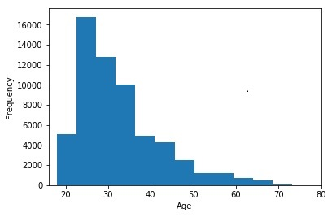
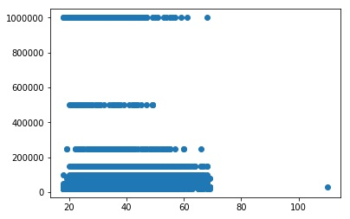
Exploration of datasets
Age data - histogram
Income data – scatter plot

Slide 3
Questions used
Regression
Can we predict income value based on the following multiple features?
age, education level, job level and status of drinking, smoking, and drugs intake.
Can we predict age based on income?
Can we predict job based on education?
Classification
Can we predict level of education (3 levels) based on the following features?
job level and status of drinking, smoking and drugs intake

Slide 4
Two new columns created – drinks_code, education_code ( other columns like job_code, smokes_code, drugs_code were also created ) – numerical values are created and the same is mapped to categorical data.
drinks_code
df.drinks_code.head()
0 2.0
1 3.0
2 2.0
3 2.0
4 2.0
Name: drinks_code,
dtype: float64
education_code
df.education_code.head()
0 3.0
1 3.0
2 3.0
3 3.0
4 1.0
Name: education_code,
dtype: float64

Slide 5
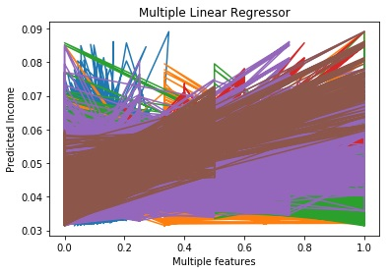
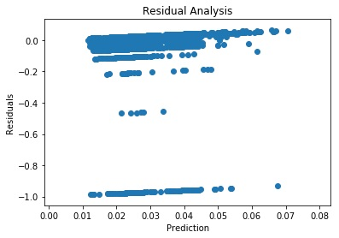
Multiple Linear Regression
MLR was used to predict income from multiple features . The following data frame was created:
x = df[['age','education_code','job_code','drinks_code','smokes_code','drugs_code']]
This was trained, generalized and tested. Model fitting time was 15.6ms and MAE was 0.0269. R2 Score is 0.00555458. R2 represents the scatter around the regression line. Low R2 value here indicates that the prediction of income is not accurate.

Slide 6
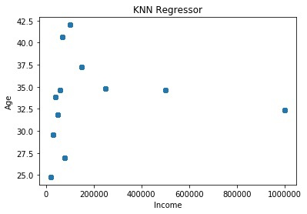
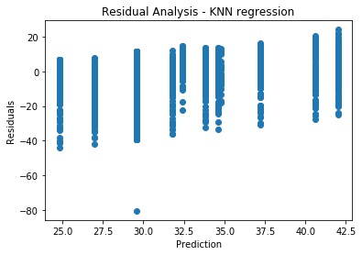
KNN Regressor
Predicted age from income – model fitting took almost no time since this is a linear regression. MAE = 6.9053. R2 Score is -0.060357387. Residual Analysis is also given.
Even here, low R2 value indicates that prediction is not accurate.

Slide 7
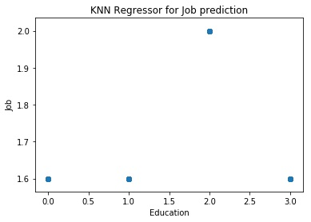
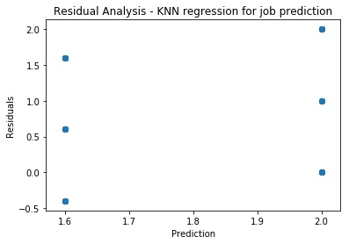
KNN Regressor – predict job from education
KNN Regression Performance on the test set: MAE = 0.4943. In this case, error is lesser.
R2 Score: -0.1208440799.
R2 Score is higher than the previous case and prediction appears to be better. There is a better correlation between education and job.

Slide 8
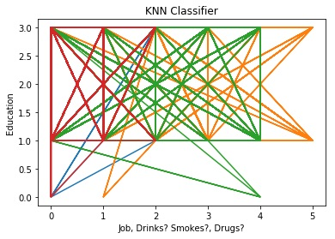
KNN Classifier
Education levels were predicted based on job level and status of drinking, smoking and drugs intake. Model fitting took 9.85s and accuracy of 0.530903328 was obtained. Precision : 0.248237347, Recall: 0.25872055, F1Score: 0.24659638. Though accuracy is above 50%, F1 score is only around 25%. This indicates that this model is not performing very well.

Slide 9
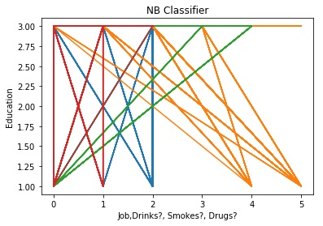
Naive Bayes Classifier
Education levels were predicted based on job level and status of drinking, smoking and drugs intake. Model fitting took 15.6ms and accuracy of 0.55542580698 was obtained. Precision: 0.22239897, Recall: 0.249777465, F1 Score: 0.180022036. Even in this case, F1 score is only 18% and this indicates that the model is not good.

Slide 10
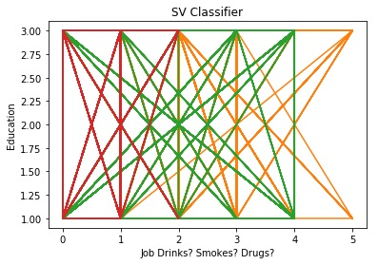
Support Vector Classifier
Education levels were predicted based on job level and status of drinking, smoking and drugs intake. Model fitting took 46.5s and accuracy of 0.56743681708 was obtained. Precision: 0.27118423 Recall: 0.26519985, F1 Score: 0.232407598. SVC model performs better than that of NB Classifier.

Slide 11
Conclusions
Can we predict income value based on the following multiple features?
We tried to predict income from multiple features using Multiple Linear Regression. But Low R2 value here indicates that the prediction of income is not accurate.
Can we predict age based on income?
Tried to predict age from income using KNN Regression (normal Linear Regression was also tried). Even here, low R2 values indicate that there is not much correlation between income and age and the model is not performing well.
Can we predict job from education?
In this case, R2 score is relatively higher and there appears to be better correlation between education and job.
Can we predict level of education based on multiple features?
We predicted education level based on job level, status of drinking, smoking and drugs intake using KNN Classifier, NB Classifier and SV Classifier. Highest F1 score obtained was for KNN Classifier and among the 3 classifiers modeled, KNN performed better, though the overall performance was not very encouraging.
There were many null values in the profiles.csv files. I had to fill them with specific values and this has created an imbalance in the data (eg: ‘income’ )and prediction results have adversely been affected by this. I feel it is important that we train the model with correct data to get better results.

